Slide 1
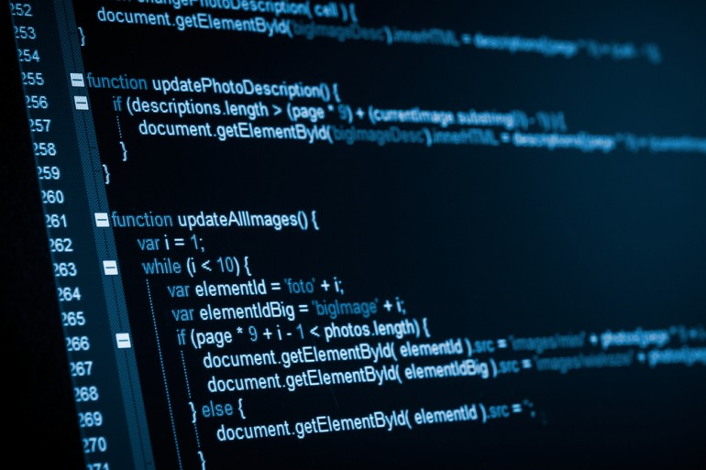
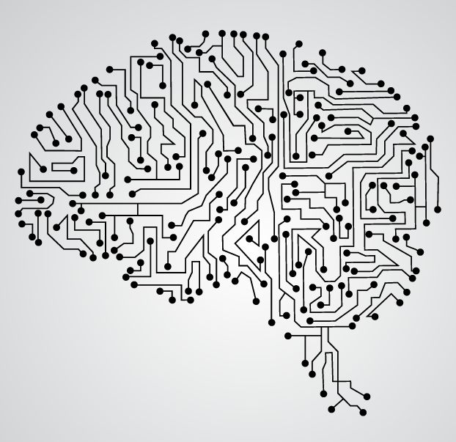
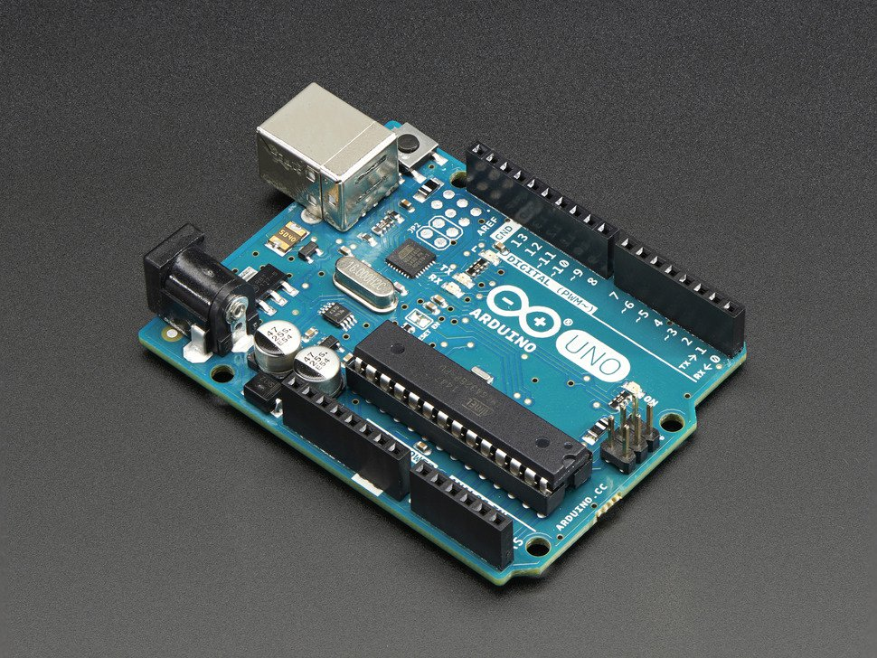
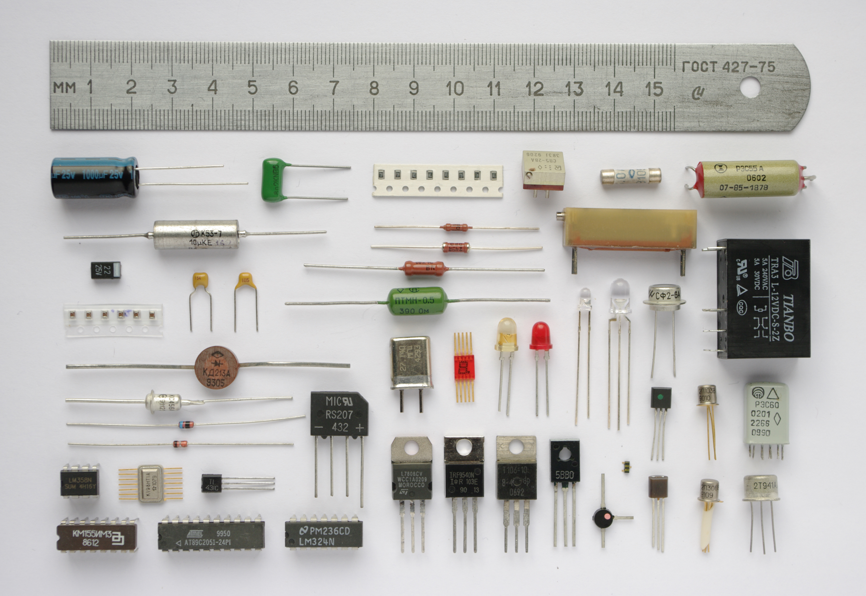
Phenomena

Slide 2
Table of Contents
About Phenomena
About Arduino
Our Goals
Potential Products
Meeting Date

Slide 3
About Phenomena
Opportunities
Investigations
Problem-solving
Collaborations
Mechanical engineering
Electrical engineering
Design aesthetics

Slide 4

About Arduino
Open Source
Cross-platform
Open source and extensible software
Open source and extensible hardware

Slide 5
Our Goals
Create a number of phenomena
Build a solid foundation in understanding circuit and electrical components
Follow the project cards
https://www.youtube.com/watch?v=PdktPANLKbs (5:29)
Develop Phenomena
Develop great skills in engineering

Slide 6

Meeting Date
Monday!
Tuesday?
Wednesday?
Thursday?
Friday?

Slide 7


